Slide 1
Goanna Planner Prediction Resources to introduce
Guṉḏa
Lesson 1: Introduce the new book and activate prior knowledge.
Before reading (don't read or show the book yet!)
Chart 1: (or butcher's paper) Get the students interest – show a real item if you can, or a photo, picture. Ask students what they already know about ḏakul – axe (fill in inner circle, can write students names next to their comments if you want assessment record)
2. Chart 2: As a whole group on A3, make dot to dot connections to expand students' ideas – pass around the circle, each student draws one line and says a sentence about what they predict.
3. Chart 3: Use pictures from the book to prompt discussion and prediction (glue onto chart for wall display): yäku?, wanhal?, yol?, nhaltjan?
4. Optional: Start lists of words with pictures: yäku?, nhäthinya?, yol?, djämamirriyam? etc
Lesson 2: Read the book for the first time.
Review chart 3 (yäku?, wanhal?, yol?, nhaltjan?) to remember the story ideas, then
Read the book
3. Check Chart 2 (dot to dot connections): was each connection yuwalk or nyäḻ (true or false)?
4. Add extra words to Chart 1 to build on prior knowledge.
5. Add some new words from the book to word lists (yäku?, nhäthinya?, yol?, djämamirriyam?)
6. Children can go to their desks and complete individual A4 dot to dot connection pages – draw lines and attempt to write some words from the charts now on display; colour in.

Slide 2
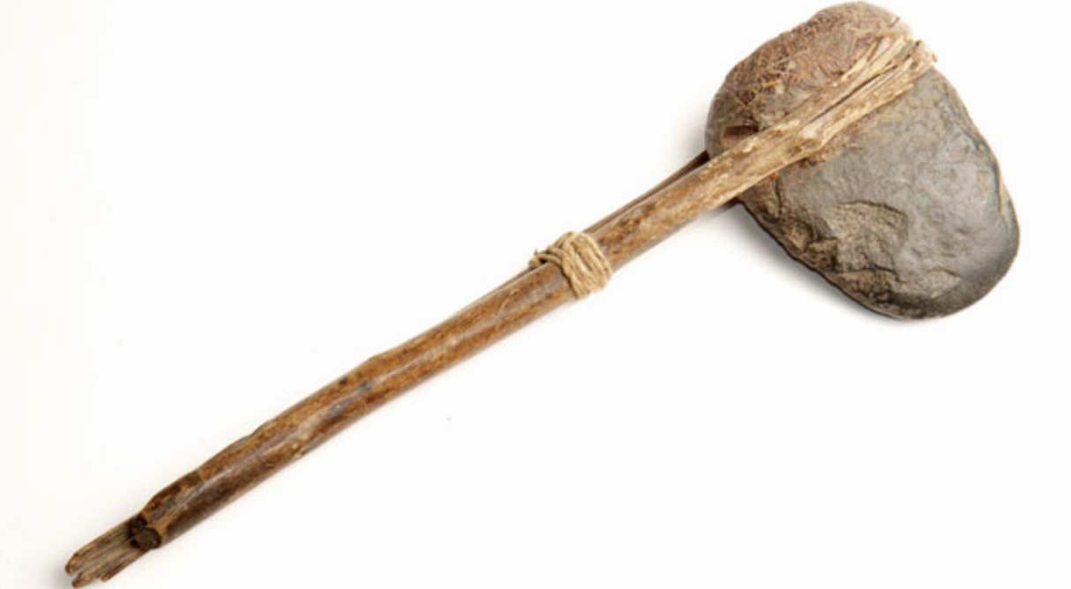
Chart 1: Before and after web: Activating prior knowledge
Limurr marŋgi
Limurr ga marŋgithirr djorra'ŋur

Slide 3
Image to support Chart 1

Slide 4
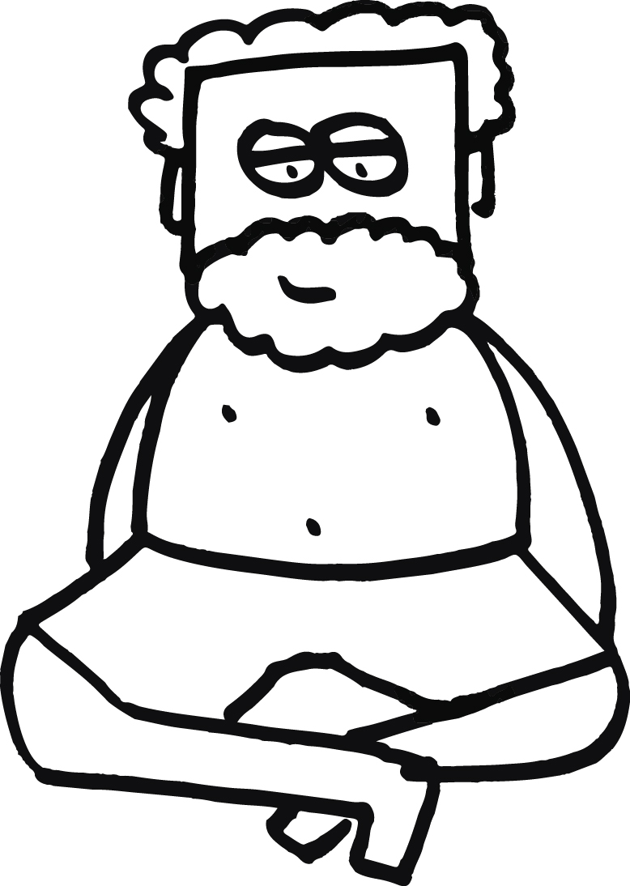
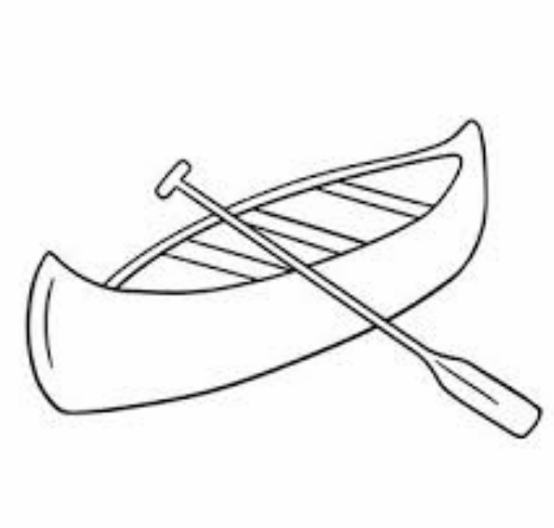
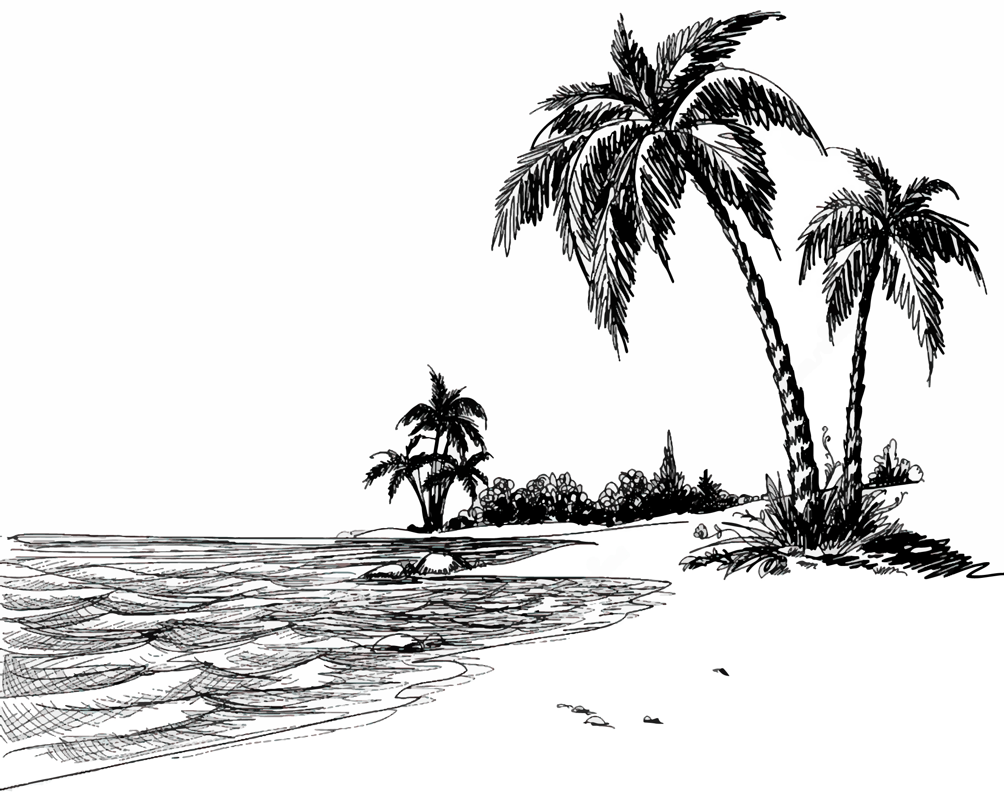
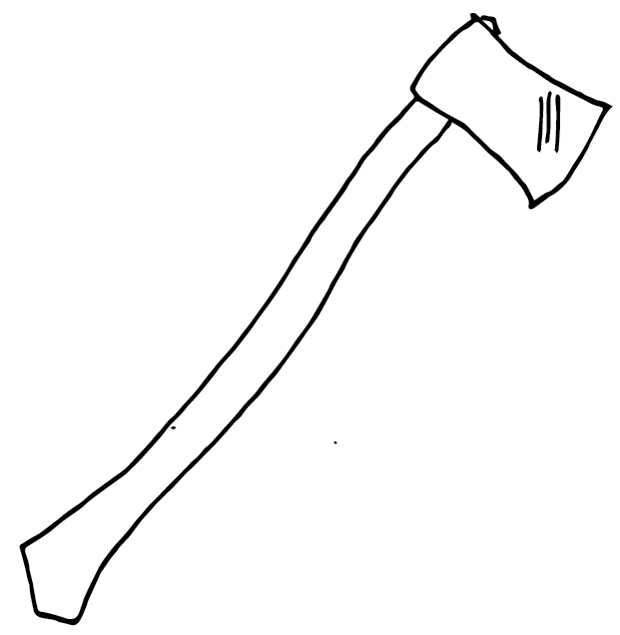
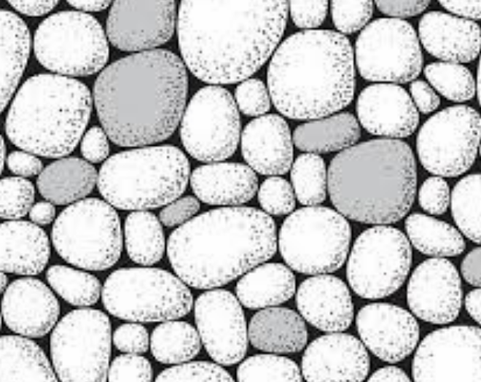
Chart 2: Dot to Dot connections. Making predictions before reading Guṉḏa: draw lines to predict what might go together in this story. Say sentences out loud to the group.
Yäku: ______________ Walu: __ / __ / ____

Slide 5
Chart 2: Dot to Dot connections. Making predictions before reading Guṉḏa: draw lines to predict what might go together in this story. Say sentences out loud to the group.
Teacher cheat sheet – to assist with prompting – however all student predictions are good – no wrong answer so encourage all predictions!
Ṉaku – canoe. A ṉaku was used by mäḻu and ŋathi to get to the small island where they hunted for turtle.
Wuḻman märi'mu – Old man granfather (paternal) taught the children how to make a knife and an axe using rocks.
Runu' - island. Ŋathi and mäḻu went on the canoe to the small runu' (island) to look for miyapunu (turtle)
Ḏakuḻ – axe. There was no knife available to the characters in the story so they used rocks to make their own knife and axe.
Guṉḏa – rocks. Guṉḏa was used in the story to create a homemade knife and axe to cut up the miyapunu (turtle).

Slide 6
Chart 3: Match pictures from the book to the correct box, display on the classroom wall
Yäku (book title)
Wanhal (setting)
Yol (characters)
Nhaltjan (plot)

Slide 7
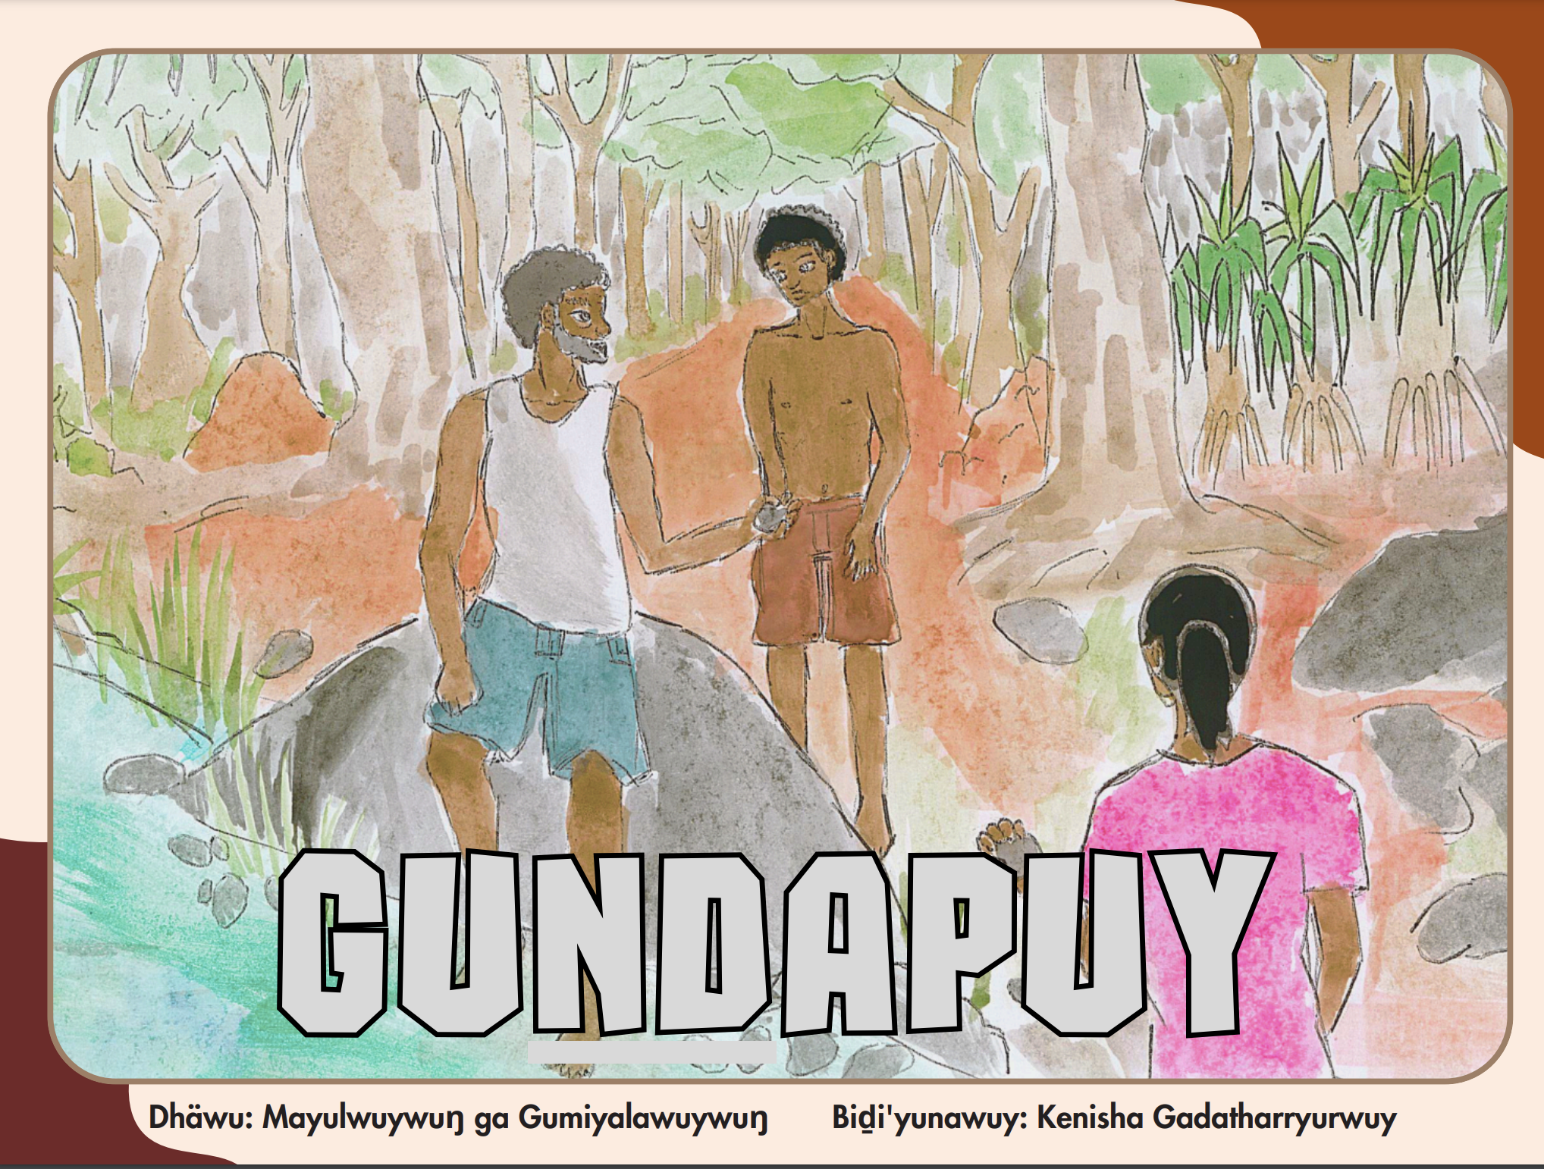
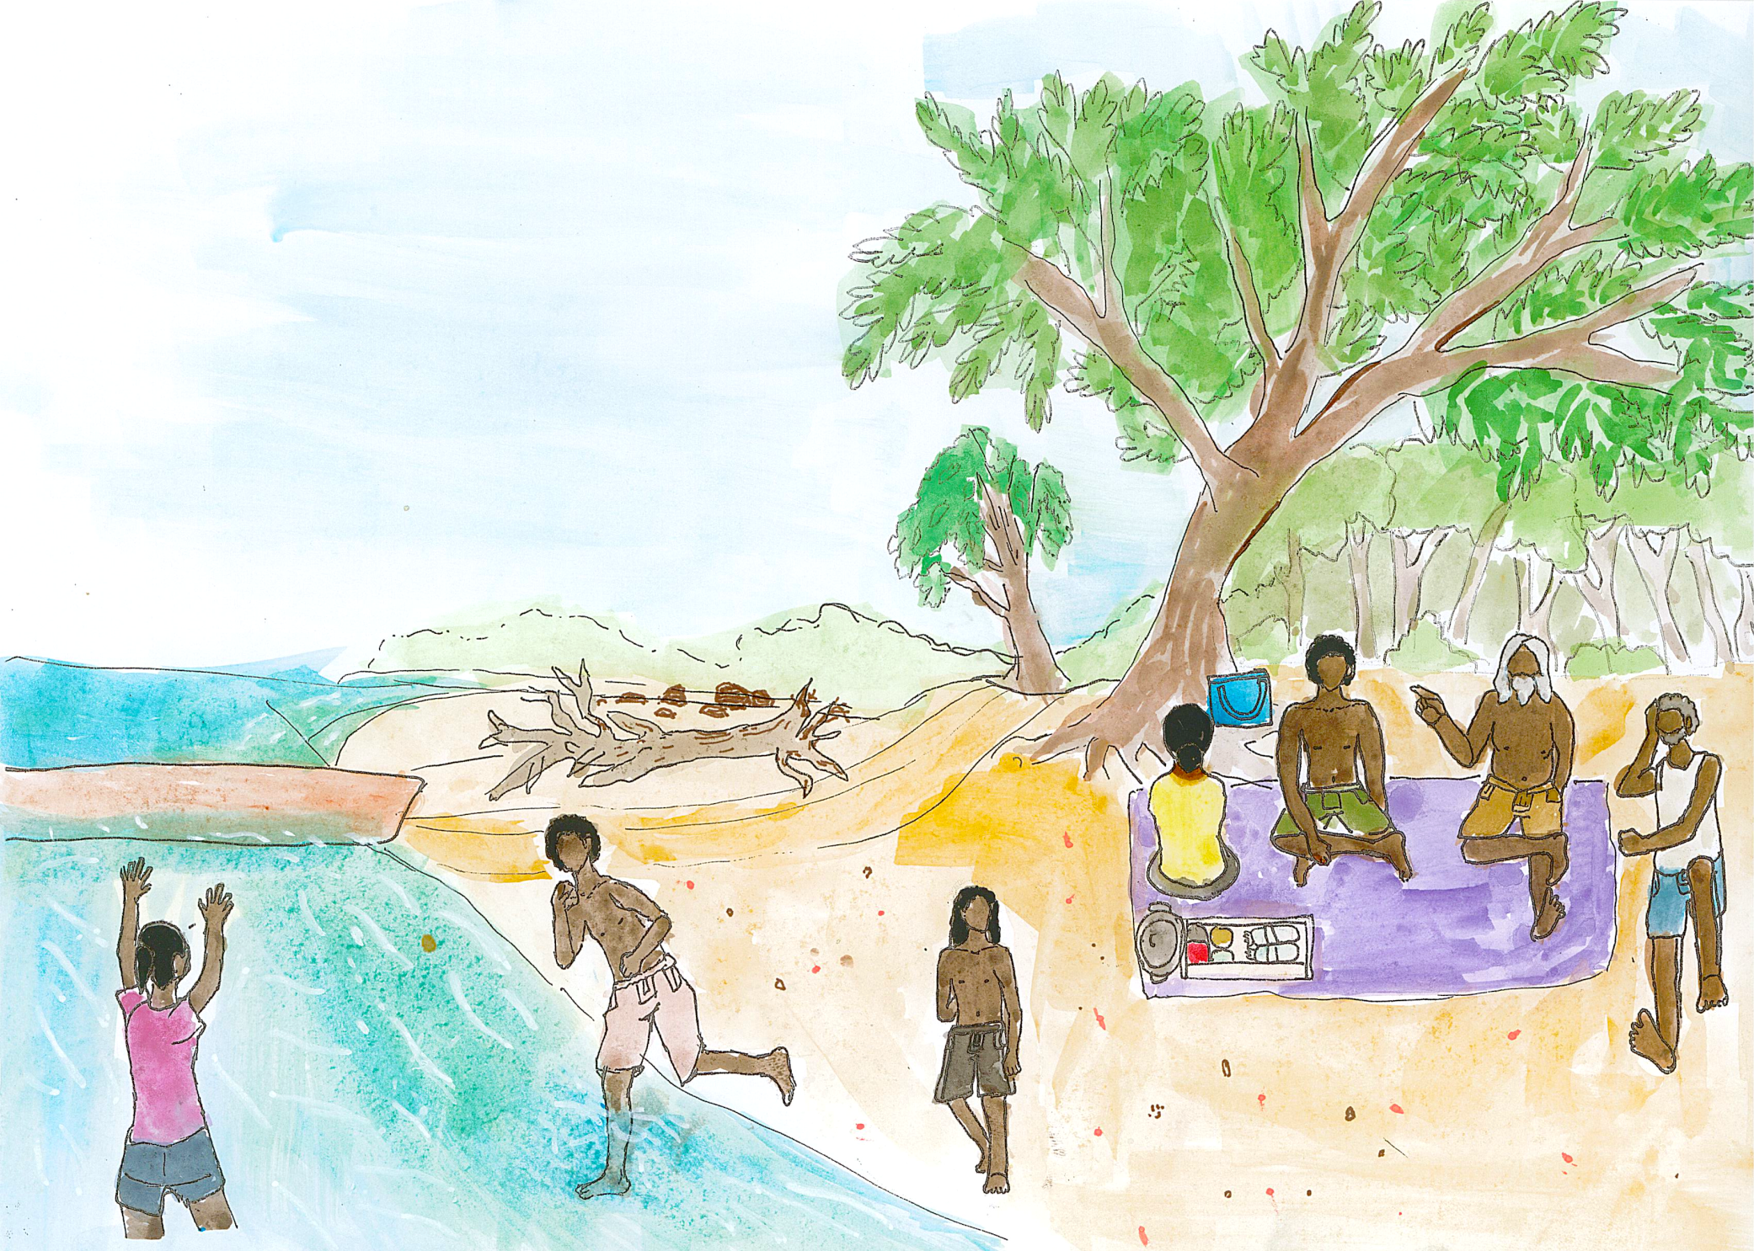
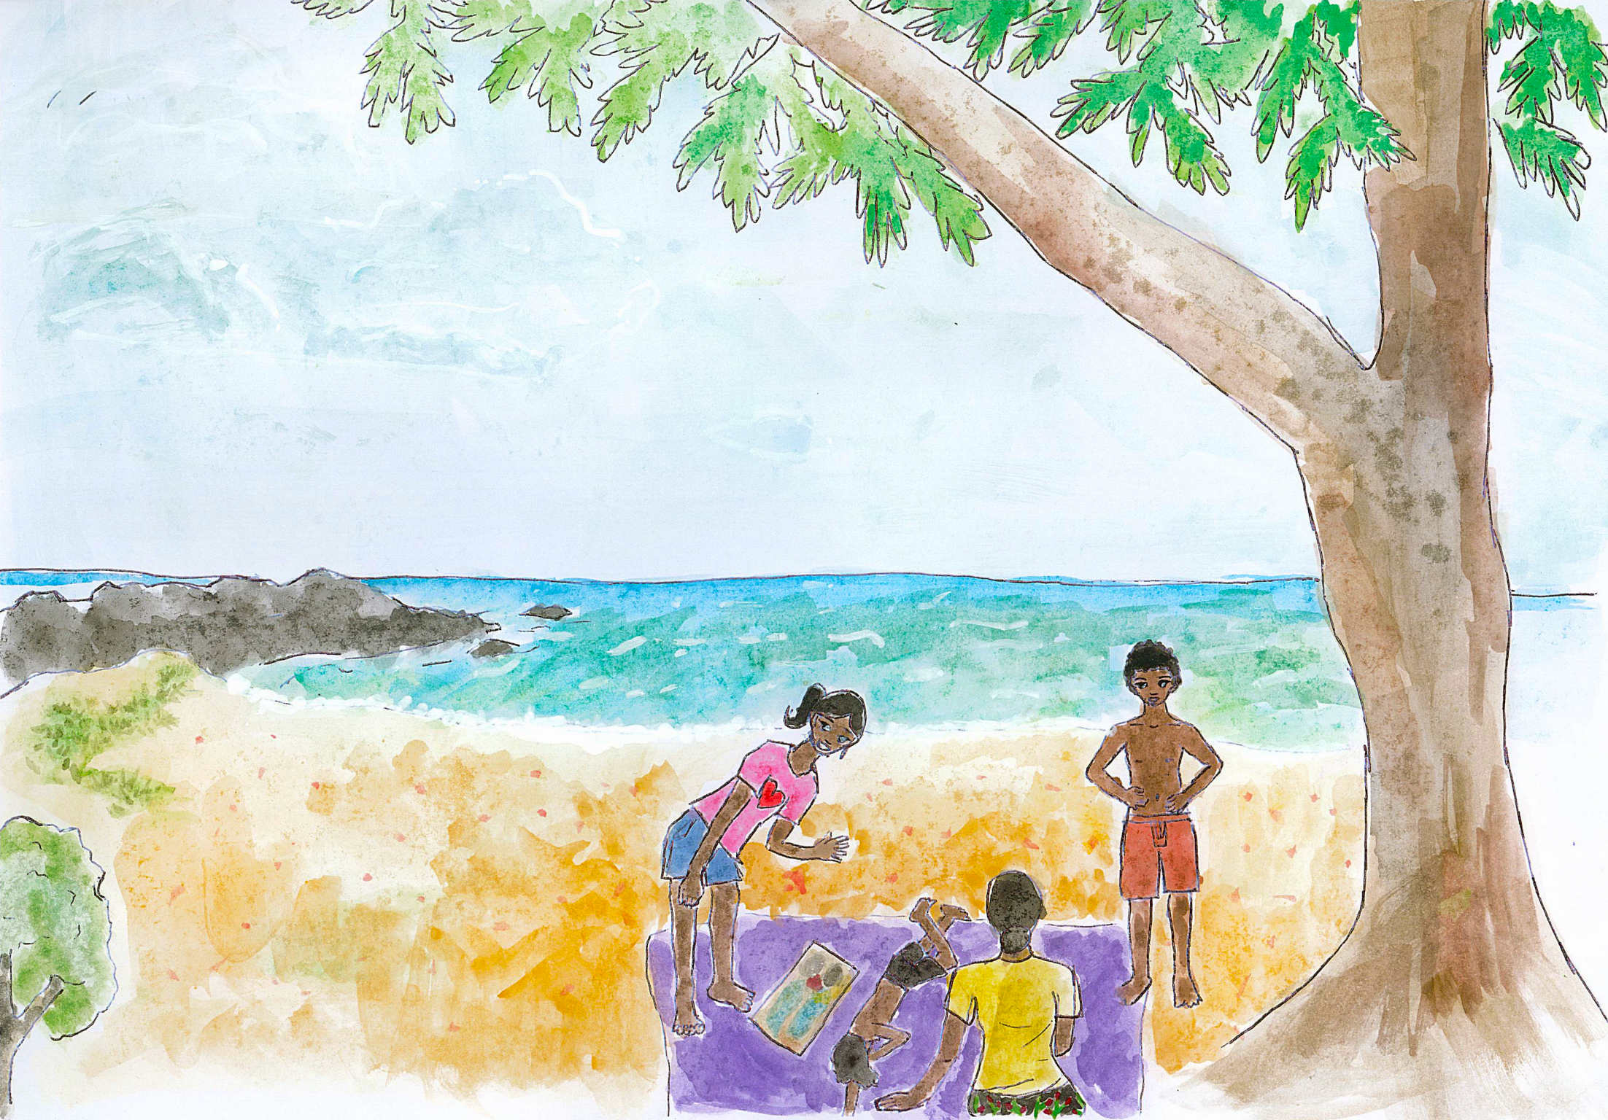
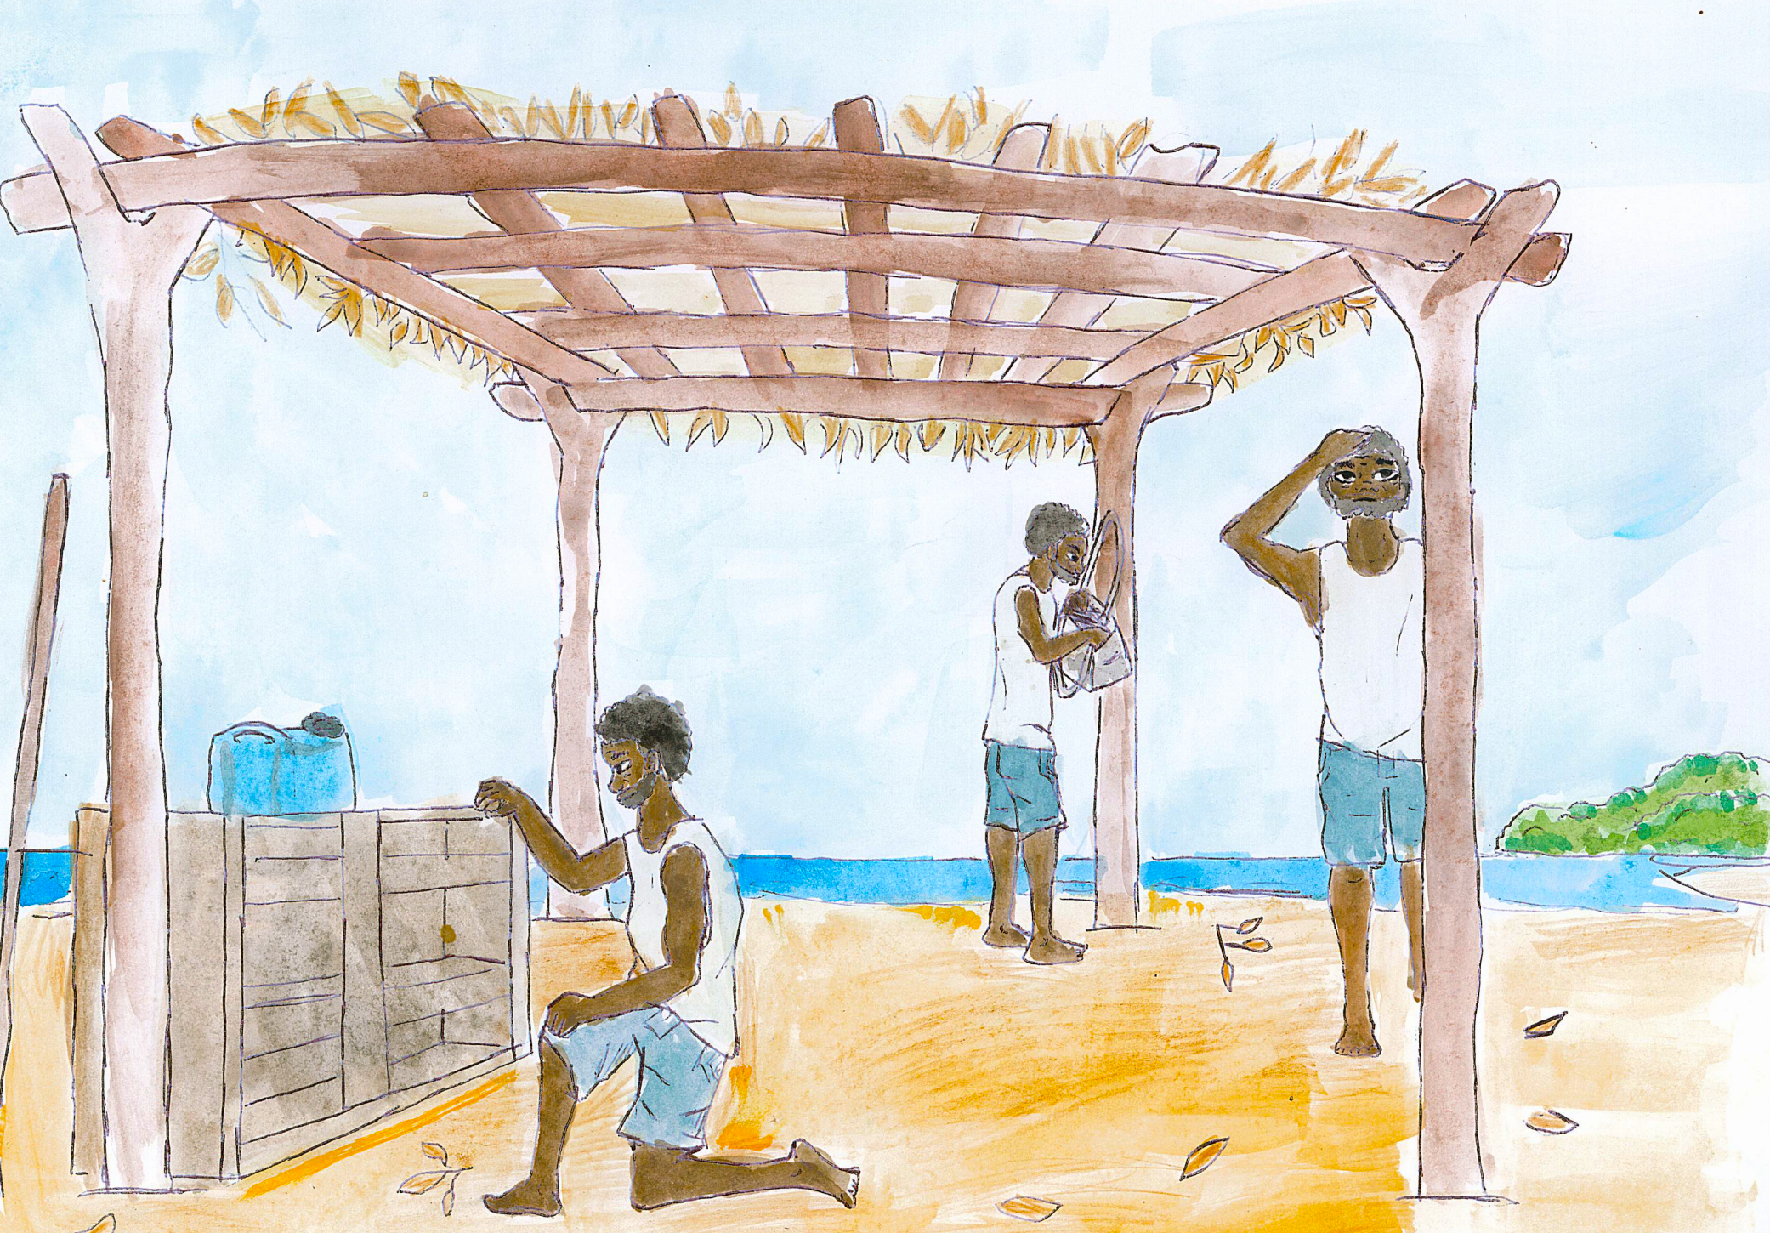
Cut these out before the lesson and present to the students in mixed order, to glue into the correct box of Chart 3.

